Slide 1
REGCGE
Selected technical topics
  Wolfgang Britz
  Institute for Food and Resource Economics, University Bonn

Slide 2
Content
File structure simulation stand alone
Parallel threads
Solving the model
Reporting part

Slide 3
File structure – stand alone sim
GUI
Set_Start_Point.gms
Regcge_settings.gms
Regcge_set_bounds.gms
Scenario
file.gms
REGCGE
Regcge_decl.gms
closure.gms
Regcge_templ.gms
From
baseline
(GDX)
Solve_model.gms
Regcge_runSim.gms
Regcge_rep.gms
GDX

Slide 4
Parallel threads (1)
Used either:
  If linked to CAPMOD: capmod starts the threads and collects the results
  A special mode of REGCGE
Each threads solves one Member State %myMS% passed by the “mother thread” and stores its result in a GDX
The mother threads starts these threads (start_sim_threads) and collects the solution (collect_solution.gms)
Parallel threads use several processors

Slide 5
Parallel threads (2)
Mother
(wait until
all flags
are deleted)
MS1.flag
MSn.flag
Regcge for MSn
Regcge for MS1
MS1.gdx
MSn.gdx
MS1.flag
MSn.flag

Slide 6
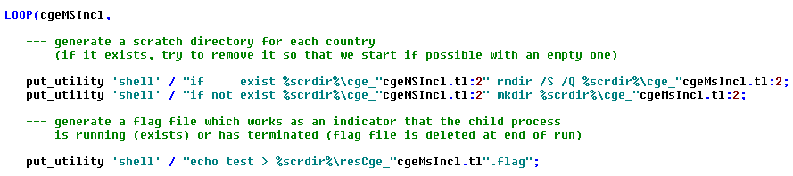
Parallel threads (3): Prepare for threads
start_sim_threads.gms
First part:
Generate a scratch dir for each country (for temp. file from GAMS,
Generate the flag file

Slide 7
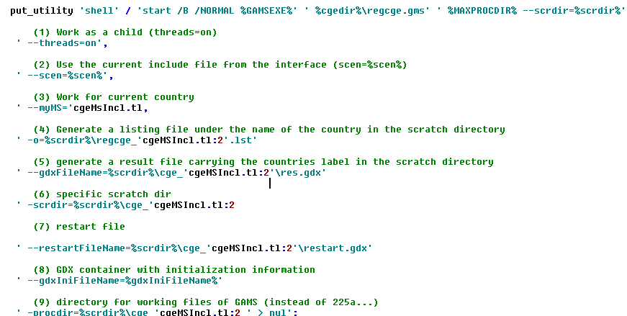
Parallel threads (4): start threads
start_sim_threads.gms
Second part: start the GAMS threads with the thread specific settings

Slide 8
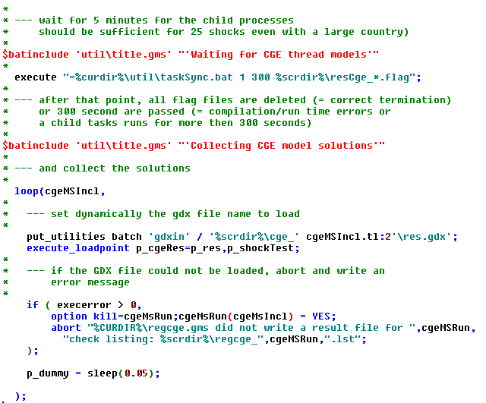
Parallel threads (5): collection
collect_solutions.gms

Slide 9
Solving the model
solve_model.gms
Model is defined both as a NLP (= with a dummy objective function, ) and as a MCP (where also inequalities are allowed)
Model might yield infeasibilities:
  Variables bounce at their bounds
  Solver might get stuck (not progress with solution)

Slide 10

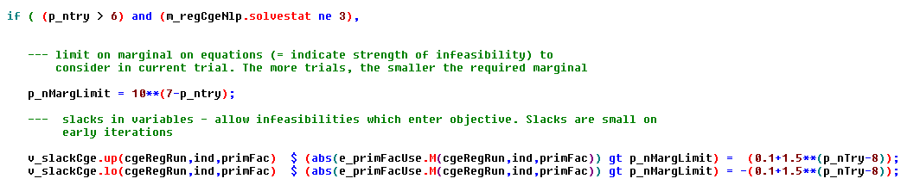
Solving the model
solve_model.gms
Infeasibilities:
  First tactic: widen offending bounds
  Second tactic: add slacks (= allowed infeasibilities) to selected equations and minimize them via the objective function

Slide 11
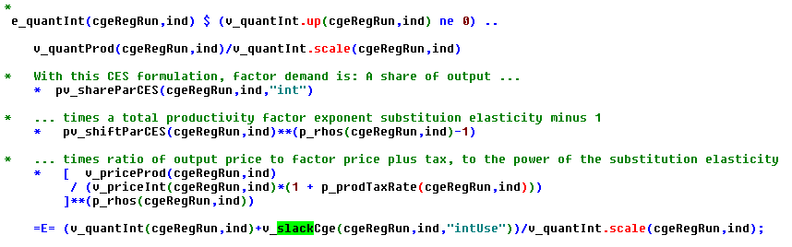
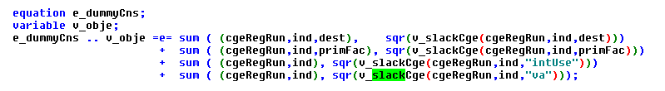
Solving the model
solve_model.gms
Slacks in equations
  Second tactic: add slacks (= allowed infeasibilities) to selected equations and minimize them via the objective function
Slacks in objective function:

Slide 12
Solving the model
solve_model.gms
Slacks in equations
  Second tactic: add slacks (= allowed infeasibilities) to selected equations and minimize them via the objective function
Slacks in objective function:

Slide 13
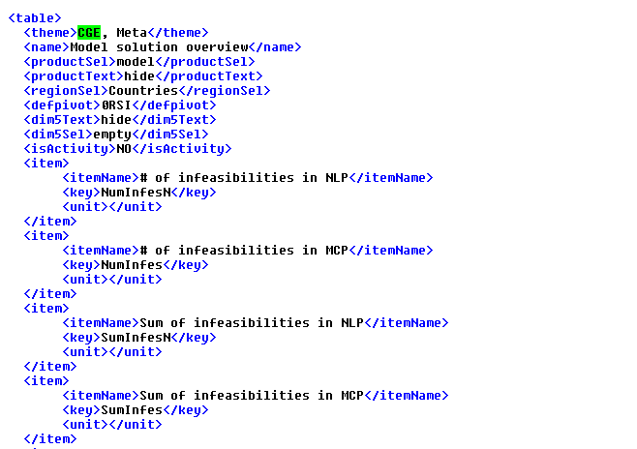
Solving the model
Reporting:
  The slacks count towards the infeasibilities
  Can hence be interpreted in Euro terms … good indication if the results can be used despite the infeasibilities
  Results are reported under “CGE, Meta, Model solution overview”

Slide 14

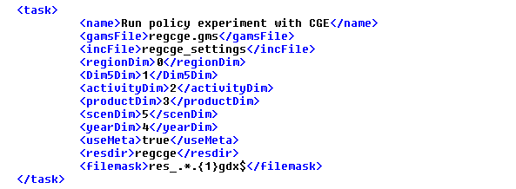
Reporting part
Same basic tactic as for CAPMOD:
  Map variables to multi-dimensional cube
Define what symbol is used and how the dimension are mapped in the “caprinew_default.xml”:

Slide 15
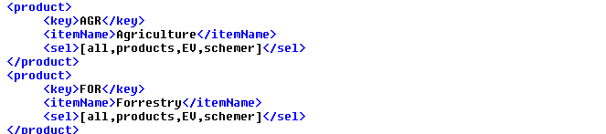
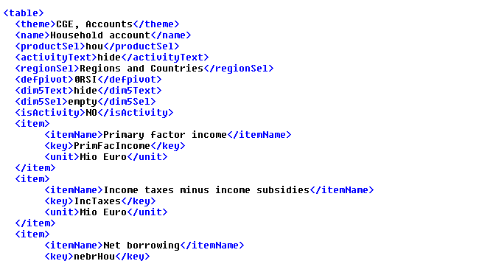
Reporting part
The elements used on these dimensions are stored in “tables.xml”, e.g.
Are used to define the views

Slide 16

Storing and viewing of the results
Under directory regcge (in stand-alone mode)
Tables.xml
p_CgeRes
GUI
views

