Slide 1
Linking CAPMOD and REGCGE
  Wolfgang Britz
  Institute for Food and Resource Economics, University Bonn

Slide 2
Content
Data
General approach
Implementation
Running a scenario
Result analysis

Slide 3
Basic idea
Let the regional programming models determine how agricultural production, intermediate input and land use develop => the CGEs must be calibrated to that information
Let the CGEs determine how primary factor prices, labor and capital use and intermediate input prices develop => Programming models must pick up that information
Update the models accordingly until they produce (almost) the same response

Slide 4
Implementation
Regional
Programming models
toRegcge
Covergence?
regcge_runSim
toCapmod

Slide 5
toRegCge
We want to send information with regard to:
  Agricultural output (quantity index)
  Agricultural price (price index)
  Agricultural input use (quantity index)
  Land use, land price and land tax

Slide 6
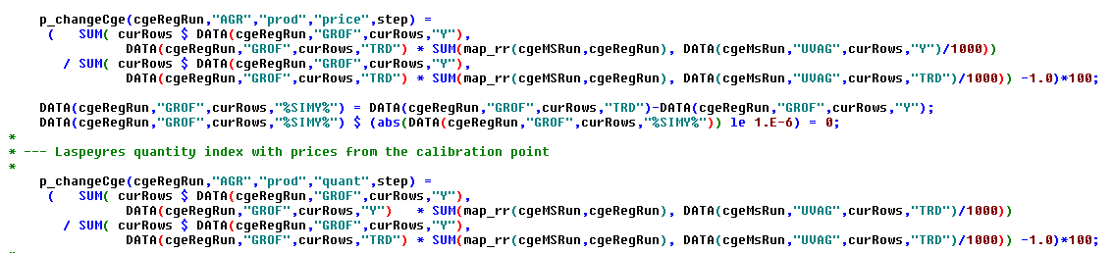
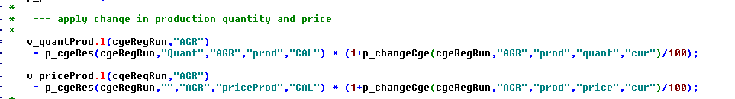
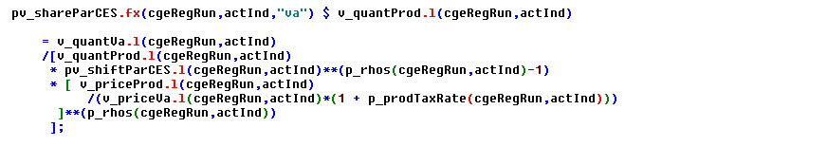
Calculation of changes (toRegCge)
CAPMOD: aggregate for agriculture
Regcge: update variables
Regcge: recalibrate production function

Slide 7
toCapmod
We want to send information with regard to:
  Prices of non-agricultural sectors => intermediate prices
  Prices for primary factors

Slide 8
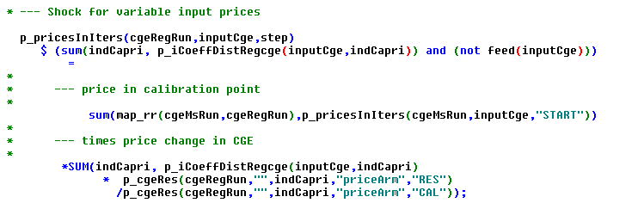

toCapmod: update of intermediate input cost
Objective function
of programming models

Slide 9
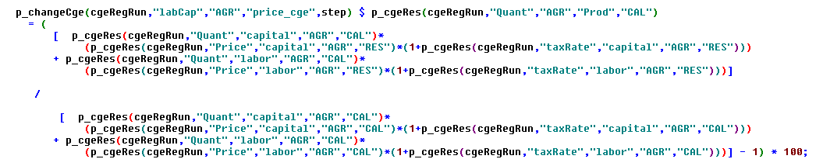

toCapmod: update of capital and labor cost
Basic idea:
  Objective function is: [Market revenues + premiums – intermediate input costs] – [labor and capital costs = PMP terms]
  => Update PMP terms to reflect changes in primary factor prices from CGE

