Slide 1
Calibration of the Supply Model
Davit Stepanyan
Thuenen-Institute of Farm Economics

Slide 2
LP Problem
 | Wheat | Barley | Rapeseed | Sugarbeet
Expected gross margin (pesos) | 253 | 443 | 284 | 516
Price | 293 | 503 | 319 | 596
cost | 40 | 60 | 35 | 80
Labor (hours/ha) | 25 | 36 | 27 | 87
Land availability: 200 ha
Labor availability: 10,000 hours
X_{i} : land devoted to crop i (in ha)
How to allocate the land to maximize the total gross margin?

Slide 3
Mathematical Formulation
Objective function: Max Z = 253 × X_{wheat} + 443 × X_{barley} + 284 × X_{rapeseed} + 516 × X_{sugarbeet}
Subject to:
X_{wheat}; X_{barley}; X_{rapeseed}; X_{sugarbeet} ≥ 0 (non-negativity constraint)
X_{wheat} + X_{barley} + X_{rapeseed} + X_{sugarbeet} ≤ 200 (land)
25 × X_{wheat} +36 × X_{barley} + 27 × X_{rapeseed} +87 × X_{sugarbeet} ≤ 10000 (labor)

Slide 4
Hands-on Exercise
Open the file called “PMP.xlsx”
Go to Sheet “LP”
Solve the LP model for
The original set of gross margins
For the 4 alternative sets of gross margins
Questions for discussion
What can you say about the responsiveness of the model with respect to changes in gross margins?
Are the results realistic?

Slide 5
Solution in Excel

Slide 6
Positive Mathematical Programing
Methodology that calibrates programming models to observed quantities to specify appropriate non-linear objective functions.
PMP is operationalized in 3 steps:
The model is forced to reproduce the observed activity levels.
The dual values (shadow prices) of the constraints are used to modify the objective function.
The new model is employed for simulations.
Notes:
To overcome the problem of overspecialisation and to reflect more realistic behaviour of farmers,
positive mathematical programming is a methodology that calibrates programming models to
observed quantities to specify appropriate non-linear objective functions

Slide 7
Positive Mathematical Programing. Step 1
$maxZ= \sum_{j=1}^{n}{p_{j}X_{j}}$ - $k_{j}X_{j}$
Subject to:
$\sum_{j=1}^{n}{a_{i,j}X_{j}}$≤$b_{i}$ [λ]
$X_{j}$≥ 0 j = 1,…,n
$maxZ= \sum_{j=1}^{n}{p_{j}X_{j}}$ - $k_{j}X_{j}$
Subject to:
$\sum_{j=1}^{n}{a_{i,j}X_{j}}$≤$b_{i}$ [λ]
$X_{j}$≥ 0 j = 1,…,n
$X_{j}$ ≤ ($X_{j}^{0}$ + e) [ρ]
Resource constraint
Calibration constraint
Marginal activities: $X^{m}$
Preferable activities: $X^{p}$
Notes:
- X_j is the level of j -th production activity
- n the number of production activities
p_j the price of production activity j
K_j the cost of production activity j
- a_i,j the quantity of the i -th resource requirement ( i = 1,..,m) to produce one unit of j –th production activity
- m is the number of resources
- b_i the amount of the i -th resource available
lambda are the dual variables associated with the resource constraints
- X_o_j are the observed production activity levels
- e is a very small number
rho are the dual variables associated with the calibration constraints
The dual values of the calibration constraints are
zero for marginal activities and equal to the difference of price and marginal cost for
preferable activities

Slide 8
Positive Mathematical Programing. Step 2
$ρ^{p}$used to specify a non-linear objective function
such that ${MC}_{X^{p}}$ = $P_{X}^{0}$
$C^{v}$= $\sum_{j=1}^{n}{d_{j}X_{j}+\frac{1}{2}\sum_{j=1}^{n}{X_{j}q_{j,j}X_{j}}}$,
where d - parameters of the linear cost term q – parameters of the quadretic cost term
Parameters are specified such that the following holds:
${MC}^{v}=\frac{∂C^{v}(X^{0})}{∂X}$ = $\sum_{j=1}^{n}{\left[d_{j}+q_{j,j}X_{j}^{0}\right]=\sum_{j=1}^{n}{[k_{j}+ρ_{j}]}}$
Linear term
Quadratic term
Notes:
Such that the optimality conditions hold: MC=P (the marginal cost of the preferable activities are equal to their respective prices at the base
year activity levels)
Rho_p – shadow prices of the preferable activities
MC_x_p – marginal costs of preferable activities
P_X_0 – prices of the respective activities in the base year

Slide 9
Positive Mathematical Programing. Step 3
The final non linear objective function reads:
$$maxZ=\sum_{j=1}^{n}{[p_{j}X_{j}−d_{j}X_{j}−\frac{1}{2}X_{j}q_{j,j}X_{j}]}$$
Subject to:
$\sum_{j=1}^{n}{a_{i,j}X_{j}}$≤$b_{i}$ [λ]
$X_{j}$≥ 0 j = 1,…,n

Slide 10
Specifying the PMP Parameters
 | d | Q
Standard approach | $$d_{j}=k_{j}$$ | $$q_{j,j}=\frac{ρ_{j}}{X_{j}^{0}}$$
Average cost approach | $$d_{j}=k_{j}−ρ_{j}$$ | $$q_{j,j}=\frac{{2ρ}_{j}}{X_{j}^{0}}$$
Paris approach | $d_{j}=$ 0 | $$q_{j,j}=\frac{k_{j}+ρ_{j}}{X_{j}^{0}}$$
Exogenous elasticities | $$d_{j}=k_{j}+ ρ_{j}−q_{j,j}X_{j}^{0}$$ | $$q_{j,j}=\frac{1}{ε_{j}}\frac{p_{j}^{0}}{X_{j}^{0}}$$
Notes:
In the 'early' days of PMP the specification problem with respect to the quadratic cost function was simply solved by letting d = c and q calculated as: … . This specification is purely motivated by computational simplicity in the absence of additional information. However, based on some ex-post simulations it was later found that that this approach results in a very poor response behaviour of the resulting model characterised by strong overreactions to changes in economic incentives.
The next approach is the average cost approach. In comparison with the standard approach the the parameters of the quadratic cost term get larger implying a reduce price elasticity.
Paris who was a famous scientist in the field of mathematical programming used an alternative specification rule. He set the linear cost function parameters d = 0 and calculated q using the following specification. Although this is a generally more realistic property of (aggregate) producer response, the quantitative specification remains somewhat arbitrary.
A generally more convincing specification is the incorporation of exogenous elasticities.

Slide 11
Hands-on Exercise. Excel
PMP reveal dual values
Open the solver
Maximize the objective function subject to calibration constraints as well as land and labor constraints
Questions for discussion
How much land is allocated to each crop?
What are the dual values for wheat, barley, rapeseed and sugar beet?
Are land and labor fully used?

Slide 12
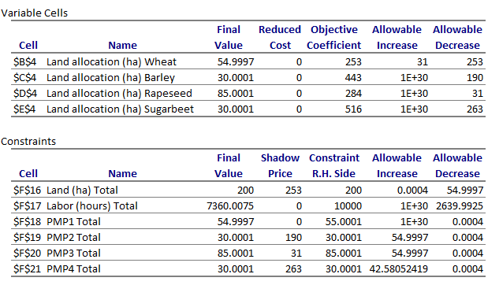
Reveal Dual Values

Slide 13
Hands-on Exercise. Excel
PMP1_Standard
Solve the PMP problem using the standard approach
What is the land allocation to each crop under the given scenraios (different price levels)?
PMP2_Average_cost
Solve the PMP problem using the average cost approach
What is the land allocation to each crop under the given scenraios (different price levels)?
PMP3_Paris
Solve the PMP problem using the Paris approach
What is the land allocation to each crop under the given scenraios (different price levels)?
PMP4_Exogenous_elasticities
Solve the PMP problem using the exogenous elasticities approach
What is the land allocation to each crop under the given scenraios (different price levels)?

Slide 14
Results

Slide 15
Hands-on Exercise. GAMS
Session_A3.2_Advanced_PMP_example.gms
Notes:
To ensure the first and second order optimality conditions (marginal revenues equal to marginal
costs, all constraints feasible, and the solution is a maximum point) hold, the shadow values of two critical constraints (land balance and milk quotas) are set
exogenously to econometrically estimated levels in CAPRI.

Slide 16
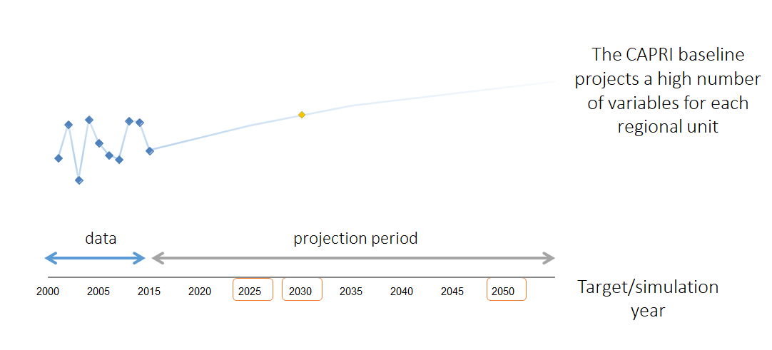
Calibration of the Supply Module in CAPRI
Finding meaningful trend estimates
Calibrate the economic models supply and market model to the meaningful trends (observation in the future)

Slide 17
Calibration of the Supply Module in CAPRI
Calibration test
Notes:
The calibration is done in calibrate_supply.gms which is called in capmod.gms.
In calibrate_supply.gms there is another filed called in named prep_cal.gms which prepares the first stage of the pmp methodology.
Cal_land_nests.gms defines land rents that enter the calibration process exogenously.
The define_pmp_terms.gms file called in from the prep_cal.gms file computes the slope (quadratic q terms) terms of the pmp.
Check_cal.gms here we reintroduce quotas and land balance after the first step of PMP and solve the resulting NLP model to check if the calibration works
Define_const_pmp_parap.gms linear pmp terms are calculated here

Slide 18
Test Calibration
Look inside gams\baseline\check_cal.gms
There is an ”abort” if a calibration test fails. Explain the code.
Run baseline calibration for Denmark
Run a simulation of the same policy for Denmark
Make sure you set ”Additional result type identifier to ”_dk”
Open the .LST file and check ”p_itemsInIters”

